Slide 1
Organization of Programming Languages
CSC 423

Slide 2
Data Types and Data Structures
Dare Muyiwa Mobolaji

Slide 3
Learning Objectives
Understand data types vs data structures
Identify common data structures
Apply structures in programming

Slide 4
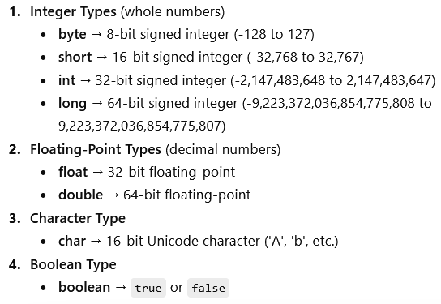
What is a Data Type?
Data type defines a set of values and operations

Slide 5
What is a Data Type?
Defines a set of values and operations
Examples:
int myNum = 5; // Integer (whole number)
float myFloatNum = 5.99f; // Floating point number
char myLetter = 'D'; // Character
boolean myBool = true; // Boolean
String myText = "Hello"; // String

Slide 6
What is a Data Type?
Data type defines a set of values and operations
Examples:
Byte byte
Stores whole numbers from -128 to 127
myByte = 120;
Short
8-bit signed integer Stores whole numbers from -32,768 to 32,767
myShort = 32000

Slide 7
Data Type
Double
Stores fractional numbers. Sufficient for storing 15 to 16 decimal digits
Double: 64-bit floating-point number double myDouble = 12345.6789;

Slide 8
Data Types vs Data Structures
Data Types
Single value (int, float,…)
Data Structures
Collection of values (Array,Trees,…)

Slide 9
Classification
Linear Structures:
Array, Linked List, Stack, Queue
Non-linear Structures:
Trees, Graphs

Slide 10
Array Structure
10 | 20 | 30 | 40 | 50

Slide 11
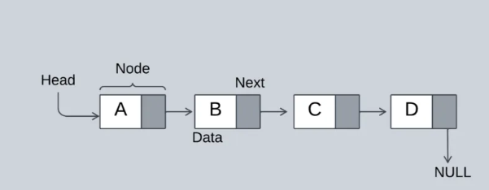
Linked List
search,insertion and delete

Slide 12
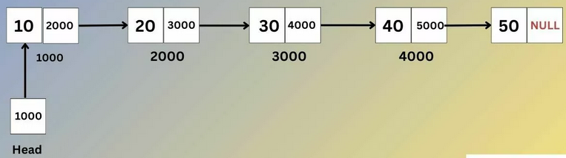
Linked List
search,insertion and delete

Slide 13
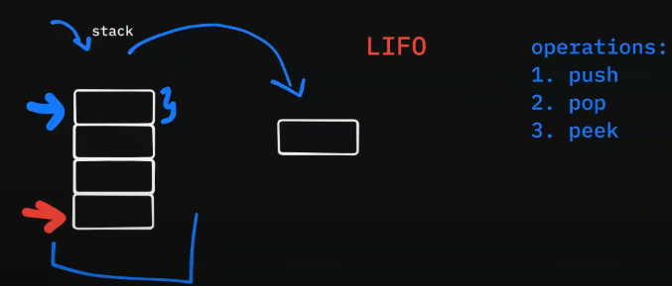
Stack (LIFO)

Slide 14
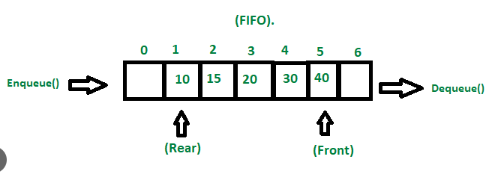
Queue (FIFO)

Slide 15
Applications
Stack → Undo operations
Queue → Scheduling
Trees → Databases
Graphs → Networks

Slide 16
Conclusion
Data types define values
Data structures organize data
Choosing the right structure improves performance

